Slide 1
1st Rotation Showcase
July 28th, 2023
Clean Transportation: Strategic Partnerships & Ventures with Jonathan Bach
Vinay Merchant

Slide 2
Agenda
About Vinay Merchant – Bio Slide
Partnership Marketing Intelligence for Leadership
Commercial Sales Strategy with Ernest & Young
Lean Business Solutions Training → Joint KPIs & Strategic Planning
Overall Impact & Major Takeaways
© 2023 Xcel Energy

Slide 3
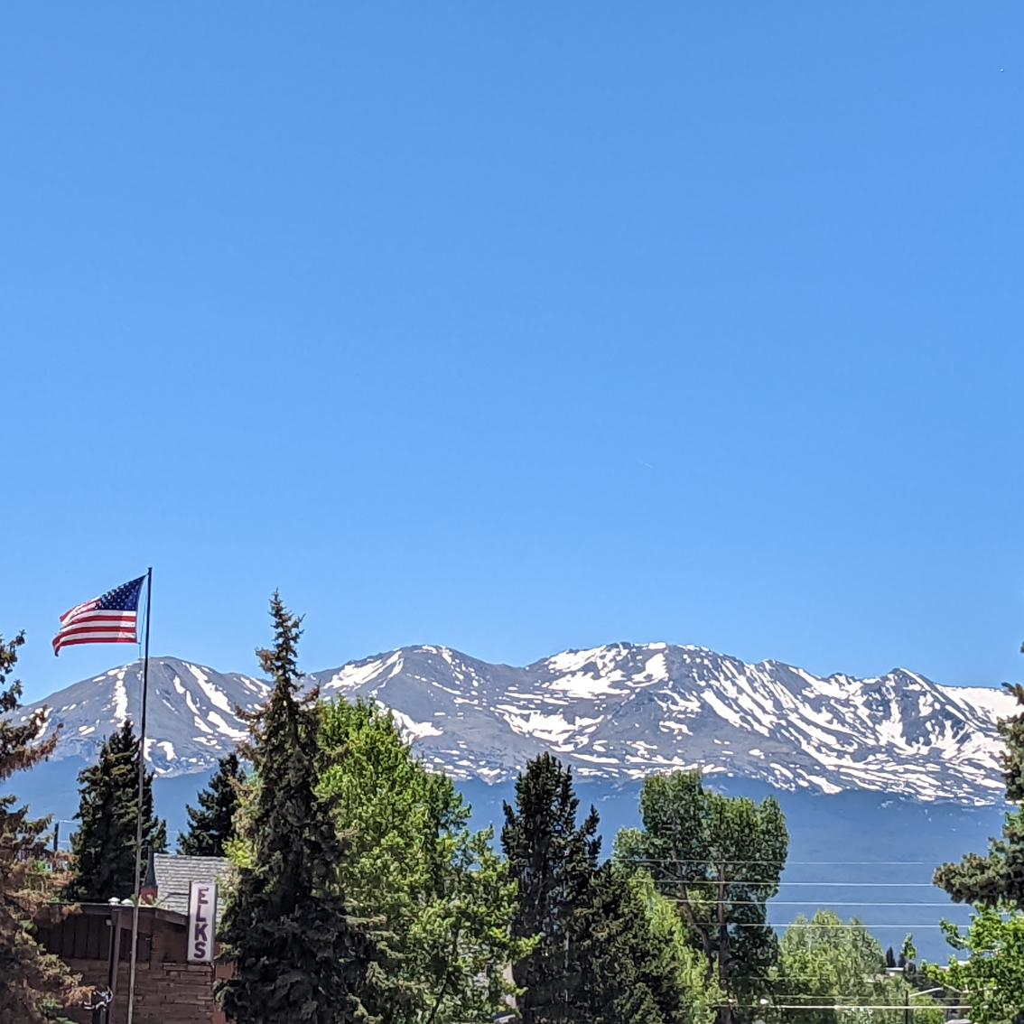
Vinay “Vee-nay” Merchant My friends call me “V”
Hometown: Denver, Colorado
Siblings: 2 older sisters
Creighton University in Omaha, Nebraska
Majors: Social Entrepreneurship and Marketing
Global Partners in Hope Intern (2021-2022)
International Non-Profit Experience
Xcel Energy (June 2022-Feb 2023)
Choice and Renewable Programs: CO Solar Team
Fun fact: I own my own website/domain
vinaymerchant.com
© 2023 Xcel Energy

Slide 4
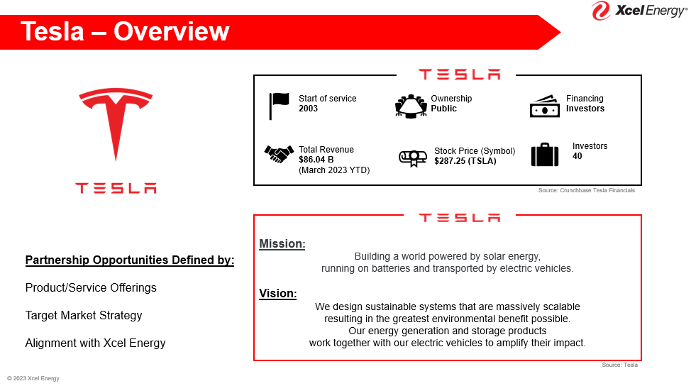
Partnerships Marketing Intelligence
Understand / Receive Intelligence Requests from CT Leaders
Utilize Darcy Partners & Bloomberg Intelligence Resources
Deliver Professional Slide Decks with Research Analysis
My Role:
Learning the intricacies of the Public Charging Market and relevant technological advancement
Researching the emerging Public Charging Industry for Market Landscape analysis, partner capabilities
Collecting and organizing research findings into easily digestible slides for senior leadership
Results:
FTE Benchmarking competitive 3rd party public charging providers (EV-go, ChargePoint, Electrify America)
© 2023 Xcel Energy
Notes:
Getting aspirin for Senior Leadership’s needs within a timely manner to prepare for informed decision making and external partnerships.

Slide 5
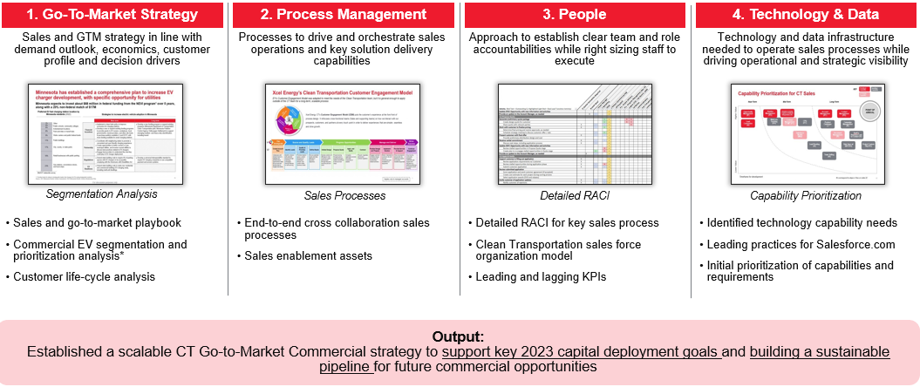
Commercial Sales Strategy with EY
Supporting an internal partnership that created a new commercial business development strategy
Result:
Go-To Market strategy
Process & People Management
Technology & Data Assessment plan
Source: EY
My Role:
Collaborating with the teams and processes involved in the sales & installation of ports
Managing Communication Channels between EY and CT Pillars
Final Deliverables File Management and Sharing
In-Person Event Planning for PSCO Workshop at 1800 Larimer
© 2023 Xcel Energy

Slide 6
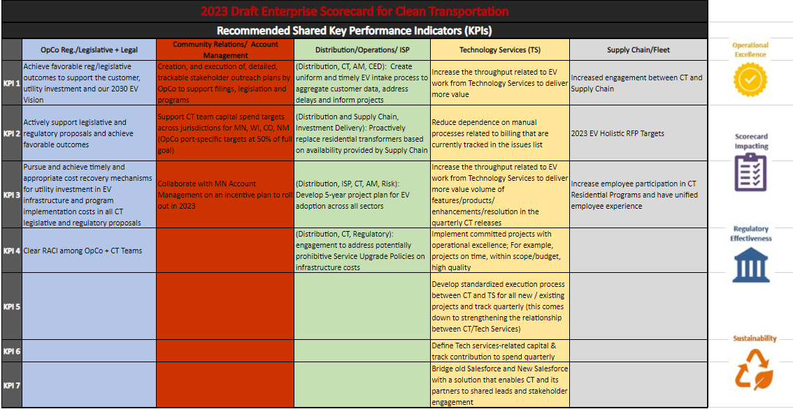
Lean Business Solutions
Filling Brandon Manley's Absence & Attending LBS Training
Result:
Learn practical problem-solving and LBS Methodology
Deliver training takeaways back to Clean Transportation Team
Impact on Organizational Culture and Initiatives
My Role:
Flexibility → Helping Fill an Immediate Organizational Need
Development of new strategic planning and road mapping efforts
Contribute to operational alignment and collaboration efforts
Update Monthly Joint KPI Scorecard & Reporting
© 2023 Xcel Energy

Slide 7
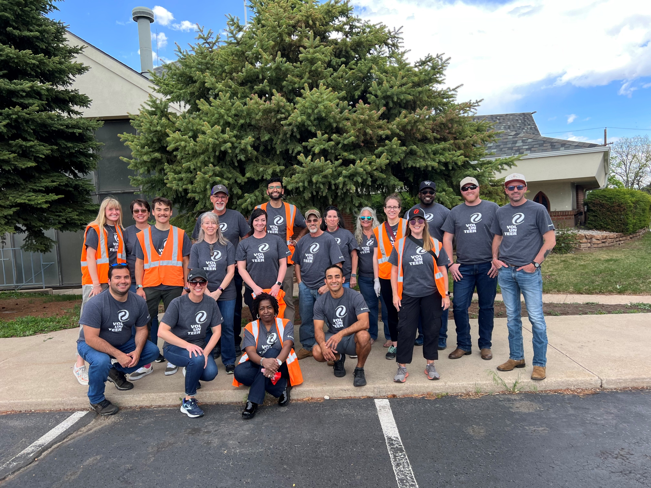
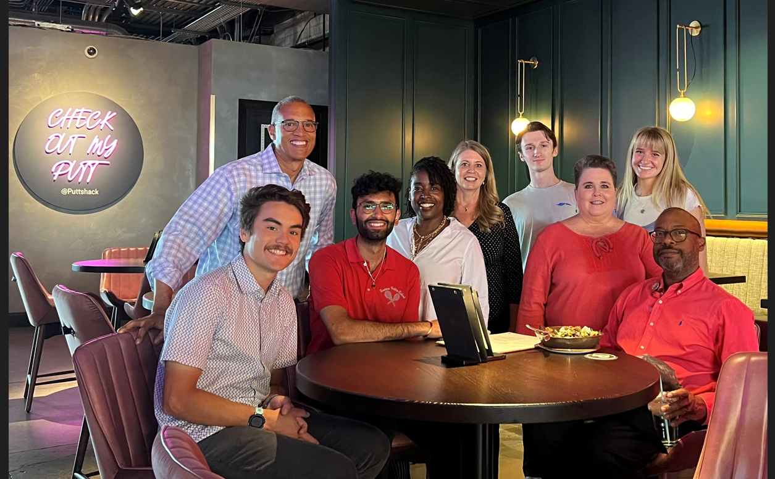
Overall Impact and Major Takeaways
Professional:
Sharpen Communication with Teams and Leaders
Discover Resources & Skills for Strategic Analysis
Collaborate within Complex Organization Structure
Change Management in a Corporate Environment
Personal:
Career Launch Community & Leaders
Supportive & Professional Social Network
Professional Development Curriculum
Career Development Discussions & Resources
Investments into my “WHY” and vision for myself
© 2023 Xcel Energy

Slide 8
Next Rotation: ePMO
ePMO & Rally Room Analyst
(Aug 1st – Early 2024)
Experience Manager: Rich Mejia
Project Manager in COS & Enterprise PMO
High Involvement with Career Launch Program
Great Resource for Learning and Support
Next Rotation:
Continued Learning and Engagement with Strategic Planning and Implementation Efforts
More Direct Engagement & Collaboration with LBS as well as several business units
Shift in entire Organizational Culture, High Need for Change Management
Develop and Deliver Project Management Toolkit for Rotation 3
© 2023 Xcel Energy

Slide 9
Thank you for listening!
Open to Questions & Responses
Vinay Merchant’s 1st Rotation
© 2023 Xcel Energy
Notes:
Acknowledge what they are saying / Inquire more about what they are asking about / Respond & Confirm (Is that Helpful?)

