Slide 1
2nd Rotation Showcase
Vinay Merchant
August 2023 - January 2024
Project Management Office & One Way Office

Slide 2
Agenda
About Vinay Merchant
One Xcel Energy Way: Continued
What is a Rally Room?
Next Rotation … and Beyond
Overall Impact & Takeaways
© 2024 Xcel Energy

Slide 3
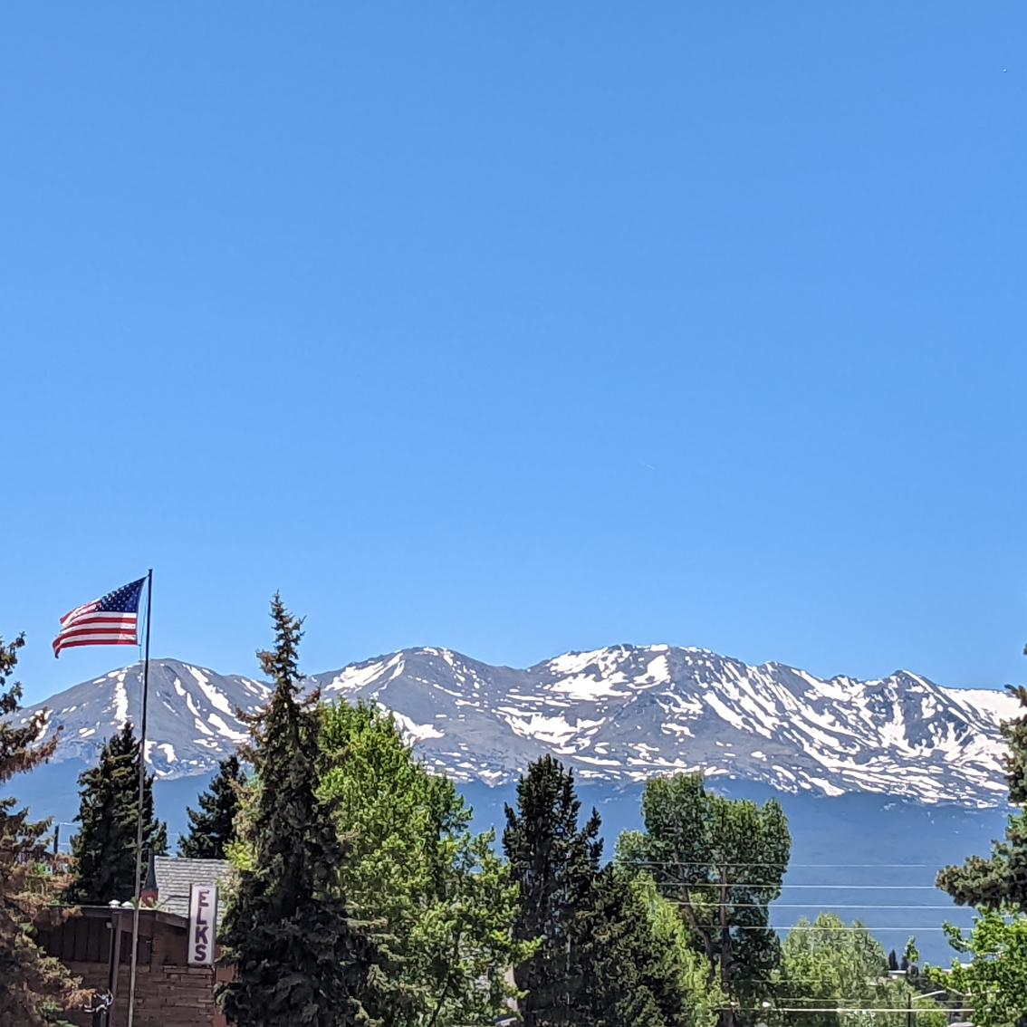
Vinay “Vee-nay” Merchant aka V
Origins: Gujarat, India
Born & Raised in Colorful Colorado
Siblings: 2 older sisters
Omaha, Nebraska (2018-2022)
BSBA: Social Entrepreneurship & Marketing
Global Partners in Hope: International Non-Profit
Denver, Colorado
Post-College Crisis
DU Masters: Organizational Leadership
Xcel Energy (June 2022 - Current)
Choice and Renewable Programs: CO Solar Team
1st Rotation: Clean Transportation with Jonathan Bach
Fun fact: I own my own website/domain
vinaymerchant.com

Slide 4
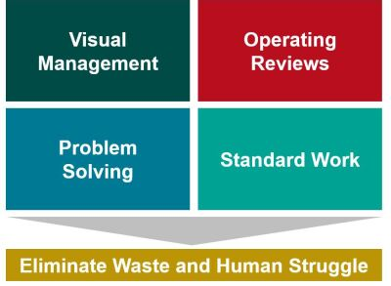
One Xcel Energy Way
Continued from LBS PPS Training
Tier 3 LBS Training & Application of Teachings
One Way Standard for Operating Reviews
Eliminating Waste & Standardizing Work
Value:
Provides training and methods to apply innovative thinking and standardization
Establishes a regular review cadence and reporting standard
Interconnects various business areas and units for collaboration
My Role / Impact:
Application of Training in Rally Rooms & Identifying Barriers to Change for Various Groups
© 2024 Xcel Energy
Notes:
Getting aspirin for Senior Leadership’s needs within a timely manner to prepare for informed decision making and external partnerships.

Slide 5
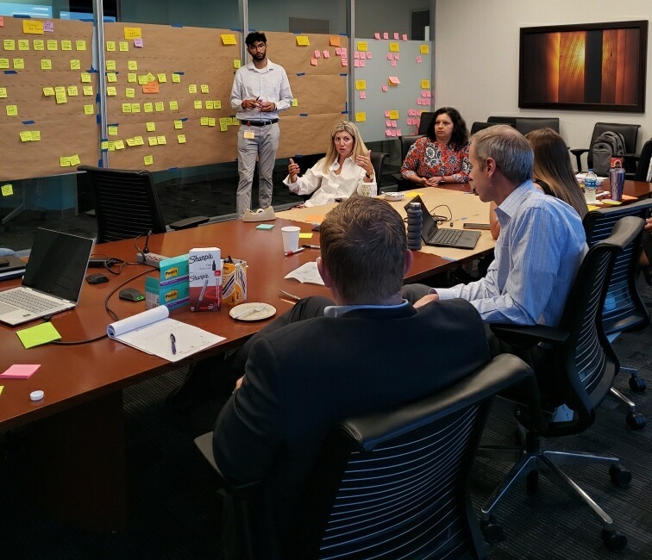
What is a Rally Room?
That’s me
“ A command center that brings together cross-functional leaders and teams to rally/manage a key objective or theme.”
Desired Results:
Visual Management for the Scope of the Work
Clear Role Responsibilities and Work Streams
Measurement of Key Performance Indicators
My Role:
Create and/or Present Weekly Operating Review Slides + Agenda
Manage Meeting Notes, Attendance, and the Roster of the Operational Reviews
Schedule Necessary Follow-Up Meetings and Keep Meeting Notes
Aid in Tactical Implementation Plan development and Project Management
© 2024 Xcel Energy

Slide 6
Let’s Take A Step Back
VALUE OF CHANGE MANAGEMENT:
Months of uncertainty and internal reorganization
Successful Implementation of Change (Volunteer Army)
Understand and Eliminate Barriers to Change
The impact of Culture on Change Management
My Rotation:
Slow culture change within a large corporation → 5+ years
Training and Application of Change Management at Xcel Energy & Denver University
Hands-on Learning Opportunities → Be Seeking Out Ways to Help!
Creating a Culture of Connection and Collaboration
© 2024 Xcel Energy

Slide 7
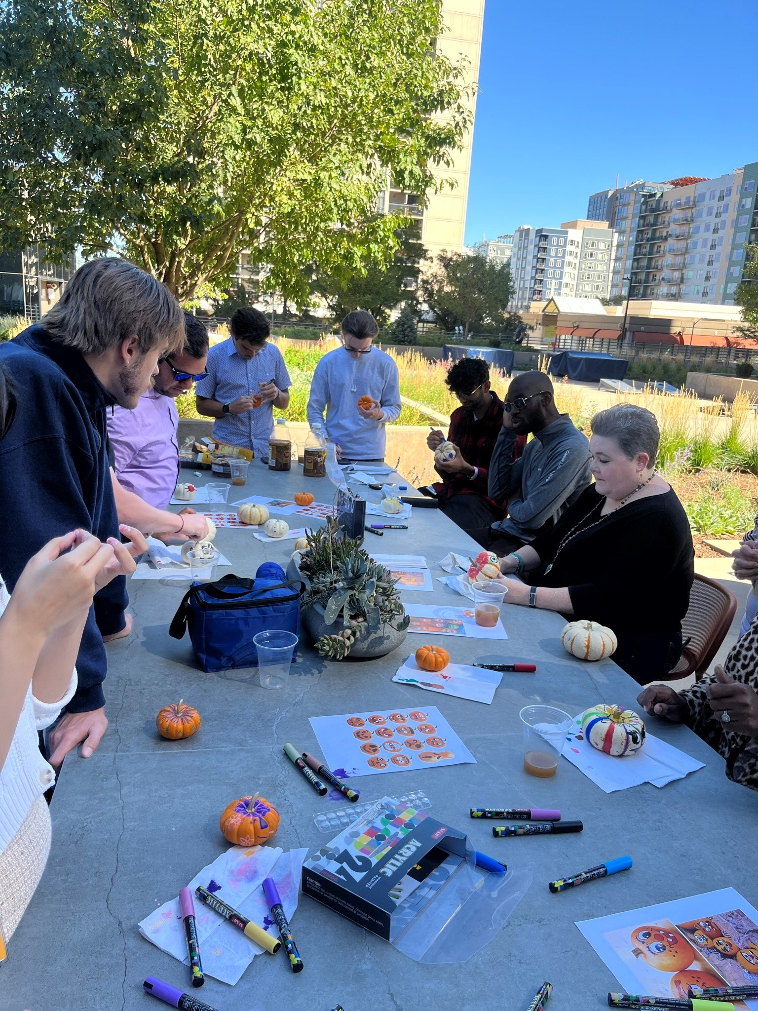
Overall Impact and Major Takeaways
Professional:
Sharpen Communication Skills with Teams and Leaders
Effectively Run Meetings or Events (with Technology)
Collaborate within Complex Organization Structure
Corporate Change Management & Strategies
Personal:
Career Launch Community and Connect Events
Navigating Uncertainty and Rapid Changes
Professional Development between Work and School
Unique and Memorable Experiences with my Peers
© 2024 Xcel Energy

Slide 8
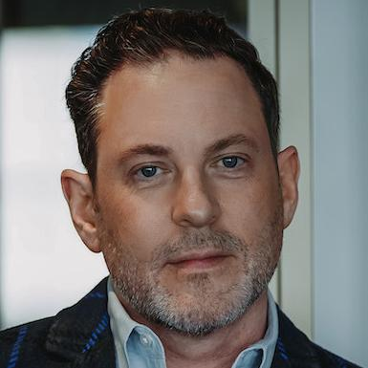
Next Rotation:
Talent Strategy Analyst
(Feb 1st – August 2024)
Experience Manager: Jamie Barrie
Principle Talent Management Consultant
One Xcel Energy Way Behaviors
Talent Acquisition
Next Rotation:
Project Management for New Xcel Energy Behaviors enterprise-wide rollout
Contribute to Change Management, Marketing, and Communication
Design Talent Management Deliverables for New Behaviors
Other Talent Strategy Programs
© 2024 Xcel Energy

Slide 9
Thank you for listening!
Open to Questions & Responses
Vinay Merchant’s 2nd Rotation
© 2024 Xcel Energy
Notes:
Acknowledge what they are saying / Inquire more about what they are asking about / Respond & Confirm (Is that Helpful?)

